Slide 1
Finding the Subnet, Broadcast and Useable Host Ranges
Lecture 6
VLSM

Slide 2
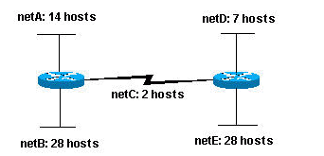
Problem
Given the class C network 204.15.5.0/24, subnet the network in order to create the network in figure below with the host requirement shown.

Slide 3
Solution
Looking at the network shown in Figure you can see that you are required to create five subnets. The largest subnet must support 28 host addresses. Is this possible with a Class C network? and if so, then how?
You can start by looking at the subnet requirement. In order to create the five needed subnets you would need to use three bits from the Class C host bits.
Since you need three subnet bits that leaves you with five bits for the host portion of the address. How many hosts do this support?
2⁵ = 32 (30 usable). This meets the requirement.

Slide 4

Cont.
Since you need three subnet bits that leaves you with five bits for the host portion of the address. How many hosts do this support?
2⁵ = 32 (30 usable). This meets the requirement. Therefore you have determined that it is possible to create this network with a Class C network. An example of how you might assign the subnetworks is:

Slide 5
Cont.
In all of the previous examples of subnetting, notice that the same subnet mask was applied for all the subnets. This means that each subnet has the same number of available host addresses. You can need this in some cases, but, in most cases, having the same subnet mask for all subnets ends up wasting address space. For example, in the previous section, a class C network was split into eight equal-size subnets; however, each subnet did not utilize all available host addresses, which results in wasted address space.

Slide 6
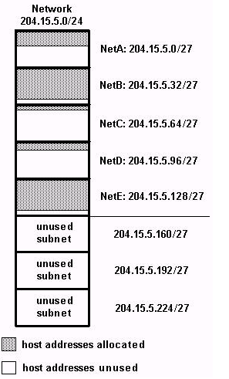
Cont.
Figure illustrates that of the subnets that are being used; Net A, Net C, and Net D have a lot of unused host address space. It is possible that this was a deliberate design accounting for future growth, but in many cases this is just wasted address space due to the fact that the same subnet mask is being used for all the subnets.

Slide 7
Introduction
VLSM is a process of dividing an IP space into the subnets of different sizes without wasting IP addresses.
When we perform subnetting, all subnets have the same number of hosts, this is known as FLSM (Fixed length subnet mask).
In FLSM all subnets use same subnet mask, this lead to inefficiencies.
In real life scenario, some subnets may require large number of host addresses while other may require only few addresses.
VLSM is simply subnetting a subnet
VLSM is also known as classless subnetting.

Slide 8
Cont.
For example, assume that you are a network administrator of a software farm. Company has three departments connected with WAN links.
Development department have 74 computers.
Production department have 52 computers.
Administrative department have 28 computers.
All departments are connected with each other via wan link.
Each WAN link requires two IP addresses.

Slide 9
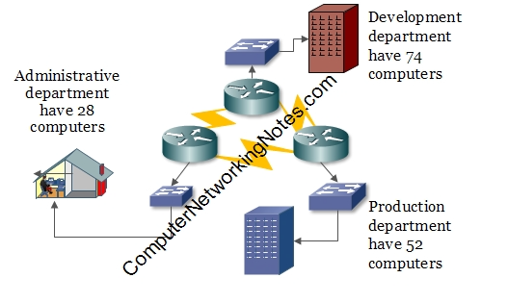
Cont.

Slide 10
Cont.
The company is given two class C address spaces
    192.168.1.0
    192.168.2.0
Subnetting of first address 192.168.1.0/25 would give us 2 subnets and 128 hosts in each subnet.
Subnetting of second address 192.168.2.0/26 would give us 4 subnets and 64 hosts in each subnet.
Collectively we are getting 6 subnets and 512 hosts from these two address spaces. We are wasting more than 300 IP address.

Slide 11
Cont.
Variable Length Subnet Mask (VLSM) extends classic subnetting. VLSM is a process of breaking down subnets into the smaller subnets, according to the need of individual networks.
In above example Company have requirement of 6 subnets and 160 host addresses.
With VSLM you can fulfill this requirement with single class C address space.
In VLSM subnetting, we do subnetting of subnets according the network requirement.

Slide 12
Steps for VLSM Subnetting
Find the largest segment. Segment which need largest number of hosts address.
Do subnetting to fulfill the requirement of largest segment.
Assign the appropriate subnet mask for the largest segment.
For second largest segments, take one of these newly created subnets and apply a different, more appropriate, subnet mask to it.
Assign the appropriate subnet mask for the second largest segment.
Repeat this process until the last network.

Slide 13
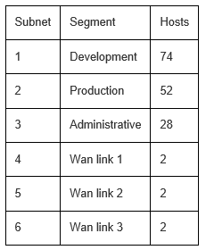
Cont.
Step 1: Oder all segments according the hosts requirement (Largest to smallest).

Slide 14
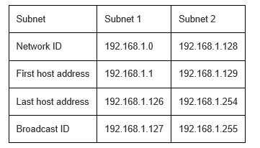
Cont.
Step 2: Do subnetting for largest segment. Our largest segment needs 74 host addresses. /25 provide us two subnets with 128 hosts in each subnet.
192.168.1.0/25

Slide 15
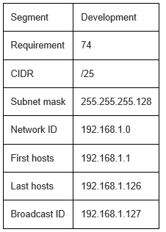
Cont.
Step 3: Assign subnet mask to the largest segment. As you can see in above table, subnet 1 fulfills our largest segment requirement. Assign it to our segment.

Slide 16
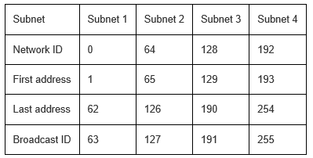
Cont.
Step 4: Do subnetting for second largest segment from next available subnet. Next segment requires 52 host addresses. Subnetting of /25 has given us two subnets with 128 hosts in each, from that we have assigned first subnet to development segment. Second segment is available; we would do subnetting of this. Subnetting of /26 provide us 4 subnets with 64 hosts in each subnet.
192.168.1.0/26
We cannot use subnet 1 and subnet 2 (address from 0 to 127) as they are already assigned to development department. We can assign subnet 3 to our production department.

Slide 17
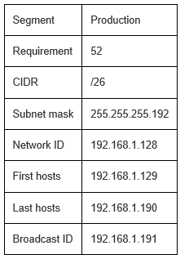
Cont.

Slide 18
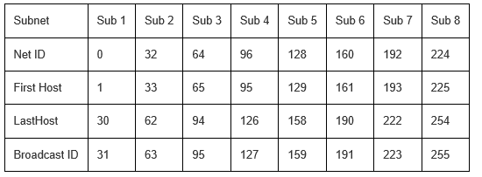
Cont.
Step 5: Our next segment requires 28 hosts. From above subnetting we have subnet 4 available. Do subnetting for the requirement of 28 hosts.
192.168.1.0/27
Subnets 1 to 6 [address from 0 to 191] are already occupied by previous segments. We can assign subnet 7 to this segment.

Slide 19
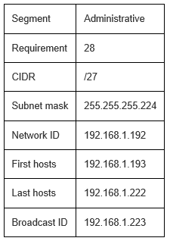
Cont.

Slide 20
Cont.
Step 6:Our last three segments require 2 hosts per subnet. Do subnetting for these.
192.168.1.0/30
Subnetting of /30 provide us 64 subnets with 4 hosts in each subnet.
Valid subnets are:-
0,4,8,12,16,20,24,28,32,36,40,44,48,52,56,60,64,68,72,76,80,84,88,92,96,100,104,108,112,116,120,124,128,132,136,140,144,148,152,156,160,164,168,172,176,180,184,188,192,196,200,204,208,212,216,220,224,228,232,236,240,244,248,252,256

Slide 21
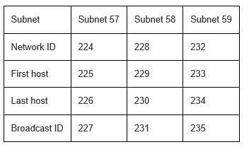
Cont.
From these subnets, subnet 1 to subnet 56 (Address from 0 - 220) are already assigned to previous segments. We can use 224,228, and 232 for wan links.

Slide 22
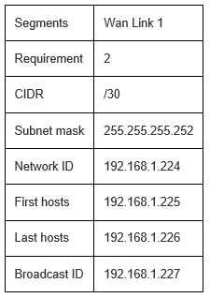
Cont.
Assign these subnets to wan links.
Wan Link 1
Wan Link 1

Slide 23
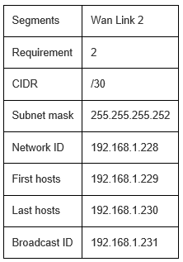
Cont.
Wan Link 2

Slide 24
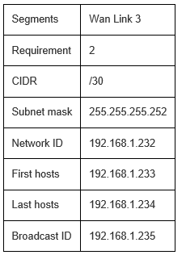
Cont.
Wan Link 3
We have assigned IP addresses to all segments; still we have 20 addresses available. This is the magic of VLSM..

Slide 25
Class Work
Given the class C network 204.15.5.0/24, subnet the network in order to create the network in figure below with the host requirement shown. Use Variable Length Subnet Mask.

Slide 26
Solution
netA: must support 14 hosts
netB: must support 28 hosts
netC: must support 2 hosts
netD: must support 7 hosts
netE: must support 28 host
netB: 204.15.5.0/27 host address range 1 to 30
netE: 204.15.5.32/27 host address range 33 to 62
netA: 204.15.5.64/28 host address range 65 to 78
netD: 204.15.5.80/28 host address range 81 to 94
netC: 204.15.5.96/30 host address range 97 to 98

Slide 27
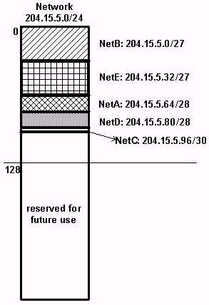
Cont.
This can be graphically represented as shown in the figure. This illustrates how using VLSM helped save more than half of the address space.

Slide 28
Class Work
An administrator have 192.168.1.0/24 network. The administrator has three different departments with different number of hosts. Sales department has 100 computers, Purchase department has 50 computers, Accounts has 25 computers and Management has 5 computers. Subnet the network using VLSM.

Slide 29
Solution
Step 1: Sort the requirements of IPs in descending order (Highest to Lowest).
Sales 100
Purchase 50
Accounts 25
Management 5
Step 2: Allocate the highest range of IPs to the highest requirement, so let's assign 192.168.1.0 /25 (255.255.255.128) to the Sales department. This IP subnet with Network number 192.168.1.0 has 126 valid Host IP addresses which satisfy the requirement of the Sales department. The subnet mask used for this subnet has 10000000 as the last octet.

Slide 30
Cont.
Step 3: Allocate the next highest range, so let's assign 192.168.1.128 /26 (255.255.255.192) to the Purchase department. This IP subnet with Network number 192.168.1.128 has 62 valid Host IP Addresses which can be easily assigned to all the PCs of the Purchase department. The subnet mask used has 11000000 in the last octet.
Step 4: Allocate the next highest range, i.e. Accounts. The requirement of 25 IPs can be fulfilled with 192.168.1.192 /27 (255.255.255.224) IP subnet, which contains 30 valid host IPs. The network number of Accounts department will be 192.168.1.192. The last octet of subnet mask is 11100000.

Slide 31
Cont.
Step 5: Allocate the next highest range to Management. The Management department contains only 5 computers. The subnet 192.168.1.224 /29 with the Mask 255.255.255.248 has exactly 6 valid host IP addresses. So this can be assigned to Management. The last octet of the subnet mask will contain 11111000.

Slide 32
Class Work
Use the most efficient IP addressing scheme possible.
Corporate network: 202.2.2.0
Corporate site: 50 hosts
Site 1: 48 hosts
Site 2: 30 hosts
Site 3: 23 hosts
Serial links: 4
Determine the IP subnet address, 1st usable host, last usable host, broadcast address and subnet mask for each.

Slide 33
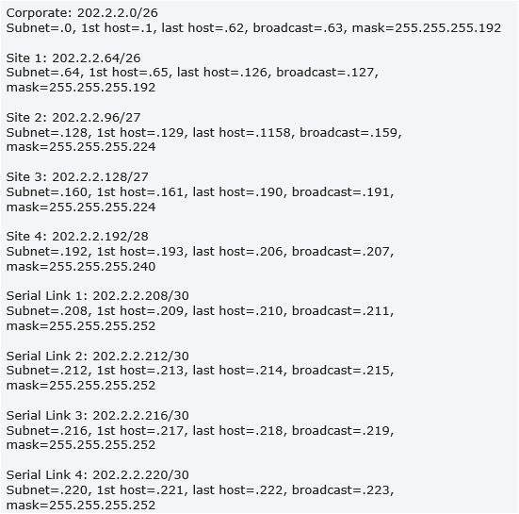
Cont.

Slide 34
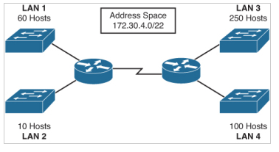
Class Work
Given the address space 172.30.4.0/22 and the network requirements shown in Figure below, apply an addressing scheme that conserves the most amount of addresses for future growth.
Solution
http://www.ciscopress.com/articles/article.asp?p=2169292&seqNum=2

